Slide 1
SOCIAL DETERMINANTS of HEALTH

Slide 2
Facts
In 2004, Costa Ricans lived, on average, to the age of 77, almost identical to life expectancy in US. Yet US per capita income was more than four times that of Costa Rica.
In 2000, inhabitants of the southern India, earning, on average, less than US$ 3000 per year, had a life expectancy of 74.6, while Washington DC residents, with almost $30000 per capita annual income, had a life expectancy of 72.6!
Why?

Slide 3
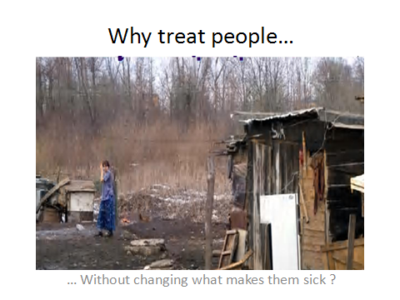

Slide 4
Social determinants of health
The social determinants of health are the conditions in which people are born, grow, live, work and age, including the health system.

Slide 5
Social determinants of health
These circumstances are shaped by the distribution of money, power and resources at global, national and local levels, which are themselves influenced by policy choices. The social determinants of health are mostly responsible for health inequities - the unfair and avoidable differences in health status seen within and between countries.

Slide 6
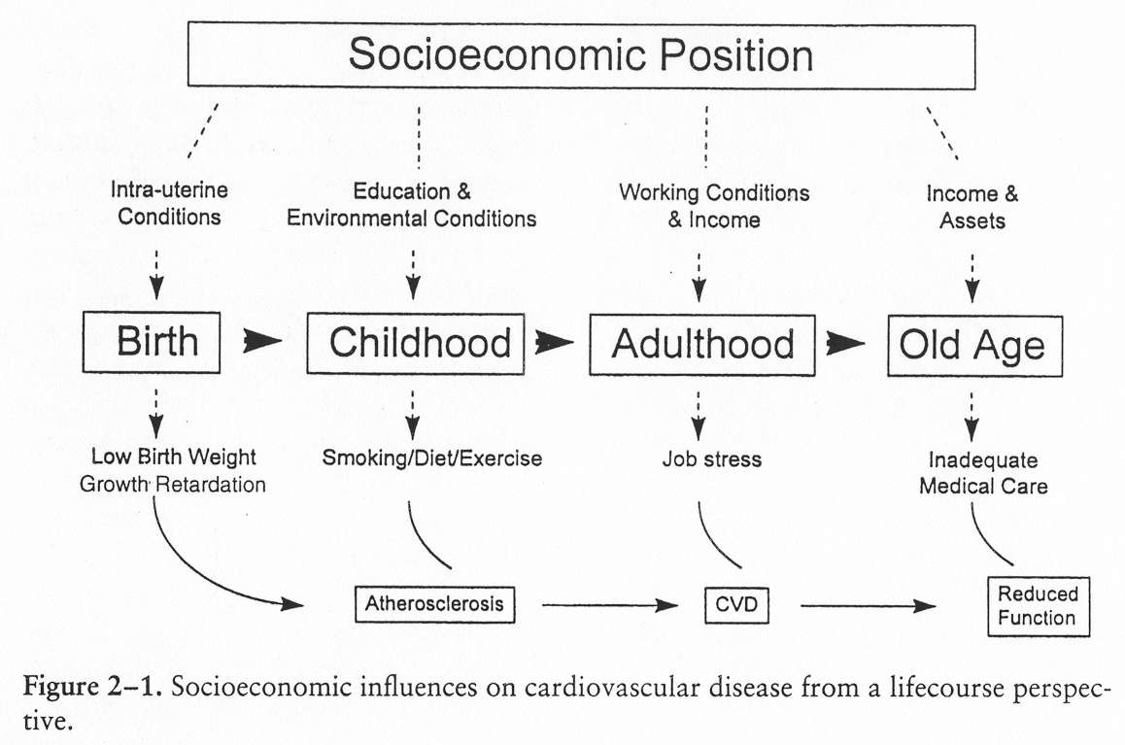
SDH are multi-sectoral and influences are throughout lifespan

Slide 7
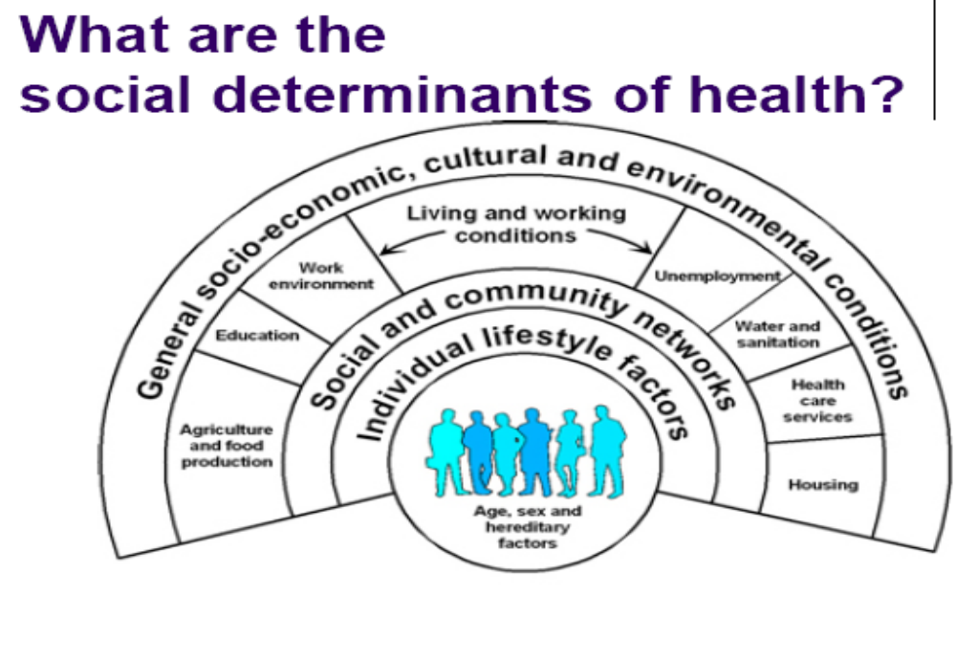

Slide 8
Themes underpinning SDH
Health equity
The absence of systematic disparities in health (or its social determinants) between more or less advantaged groups, or geographical areas.
The right to health
“The enjoyment of the highest attainable standard of health is one of the fundamental rights of every human being without distinction of race, religion, political belief, economic or social condition.”
Notes:
تشكيل زيربنا :underpinning

Slide 9
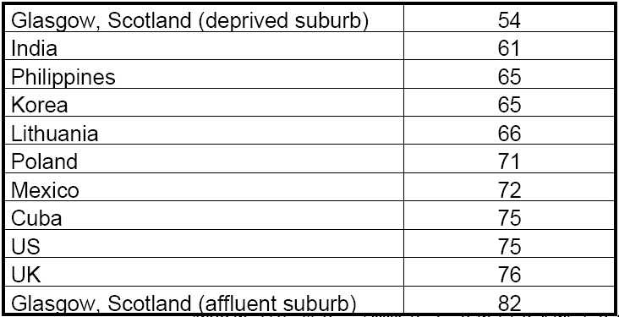
Life expectancy at birth (men)

Slide 10
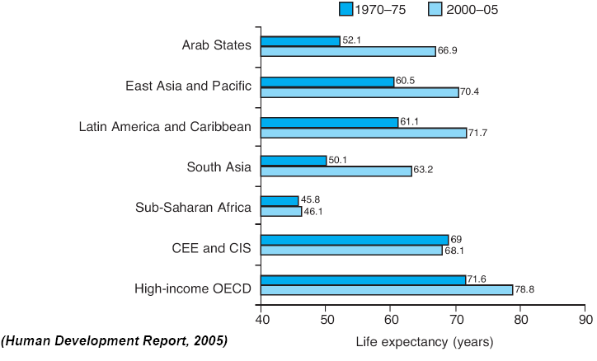
Trends in life expectancy
Notes:
CEE: Central Eastern Europe, CIS: Commonwealth of Independent States
OECD: Organization of Economic Cooperation and Development .

Slide 11
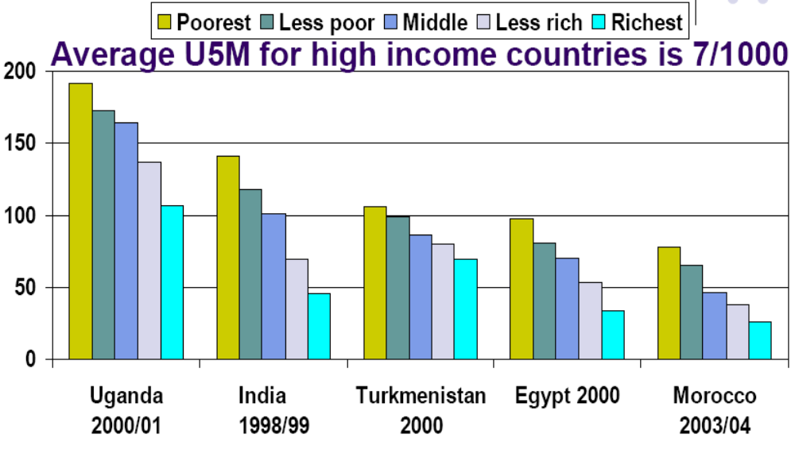
Under 5 mortality per 1000 live births by wealth quintile

Slide 12
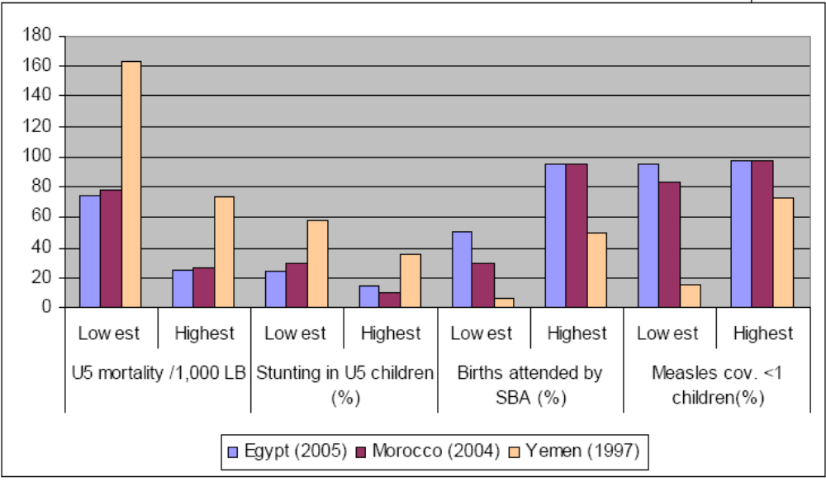
Inequities in health outcomes in countries of EMR/MENA
Notes:
"Middle East and North Africa” MENA:

Slide 13
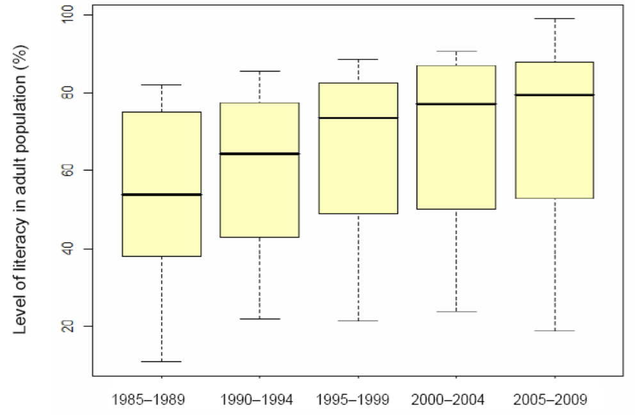
Regional trend in adult literacy in the Region, 1980–2007

Slide 14
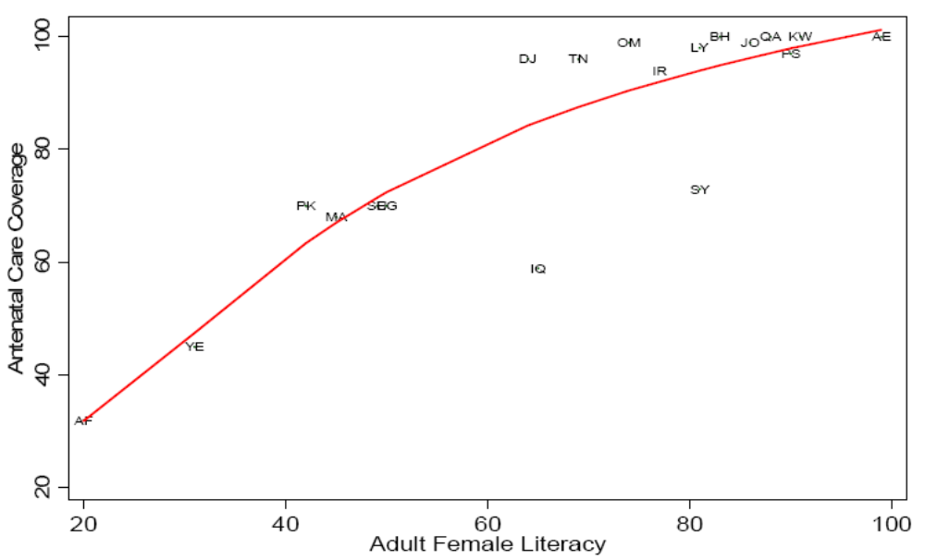
Antenatal Care Coverage by
Female literacy arte

Slide 15
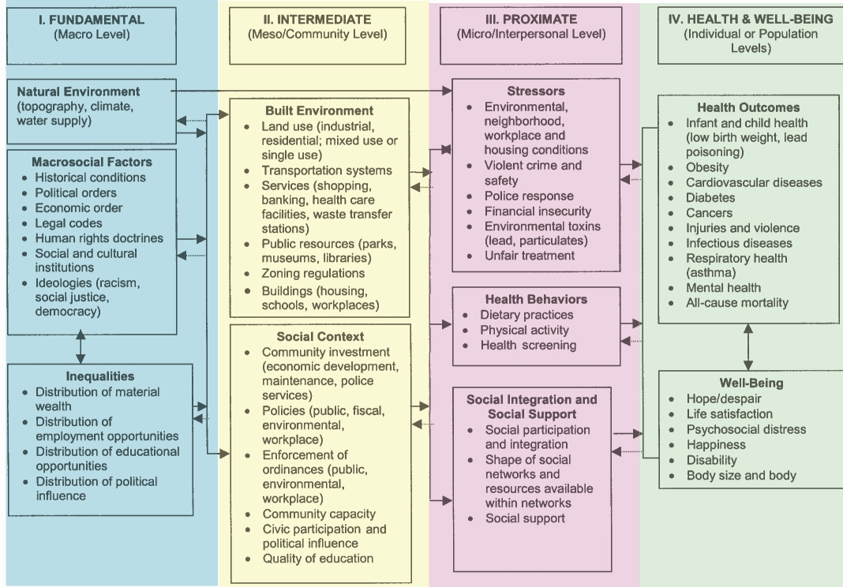
Conceptual Framework

Slide 16
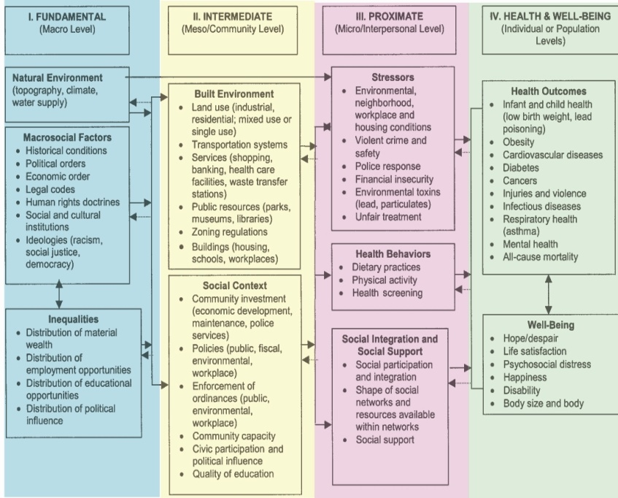
Conceptual Framework
HEALTH & WELL-BEING
Health Outcomes
Well-Being
PROXIMATE
Stressors/Buffers
Health Behaviors
Social Integration/Support
FUNDAMENTAL
Natural Environment
Macrosocial Factors
Inequalities
INTERMEDIATE
Built Environment
Social Context
Notes:
بيواسطه

Slide 17
FUNDAMENTAL
Natural Environment
Macrosocial Factors
Historical Conditions
Political Orders
Economic Order
Legal Codes
Human Rights Doctrines
Social and Cultural Institutions
Ideologies
Inequalities
Distribution of Material Wealth
Distribution of Employment Opportunities
Distribution of Educational Opportunities
Distribution of Political Influence
Notes:
دستورالعمل

Slide 18
INTERMEDIATE
Built Environment
Land Use
Transportation
Services
Public Resources
Zoning Regulations
Buildings
Social Context
Community Investment
Policies
Enforcement of Ordinances
Community Capacity
Civic Participation and Political Influence
Quality of Education
Notes:
آئين نامه هاي اجرايي

Slide 19
PROXIMATE
Stressors/Buffers
Environmental & Neighborhood Conditions
Workplace & Housing Conditions
Violent Crime and Safety
Police Response
Financial Insecurity
Environmental Toxins
Unfair Treatment
Health Behaviors
Dietary Practices
Physical Activity
Health Screening
Social Integration/Support
Social Participation and Integration
Shape of Social Networks and Resources Available
Social Support

Slide 20
HEALTH & WELL-BEING
Health Outcomes
Infant and child health
Obesity
Cardiovascular Diseases
Diabetes
Cancers
Injuries and Violence
Infections Diseases
Respiratory Health
Mental Health
All-Cause Mortality
Well-Being
Hope/Despair
Life Satisfaction
Psychosocial distress
Happiness
Disability
Body Size and Body Image

Slide 21
Quiz
Choose a health status condition or illness in your field of work and describe influential effects of social determinants of health on your chosen condition.

